Slide 1
Disciplines (Areas of Expertise) Menu Card Sorting Study: Summary & Findings

Slide 2
Card Sorting Study Overview
Background
During Reviewer Integration usability testing, when asked to find specific subdisciplines in the Disciplines menu, most users had trouble completing the following tasks:
  Identifying the main discipline (parent category) associated with a particular subdiscipline
  Locating a particular subdiscipline in the menu
Goals
  Discover how target users mentally organize and define areas of expertise/disciplines
  Determine whether the designed Areas of Expertise interaction makes sense to them

Slide 3
Card Sorting Study Overview
Format
Automated, unmoderated tool (Optimal Sort)
47 asynchronous, anonymous user sessions
40 cards (subdisciplines) sorted into categories (disciplines)
  Cards were randomly generated for each user from a master list of 73 subdisciplines.
  In addition to the predefined categories, users could create their own.
2 pre-study questions and 5 post-study questions

Slide 4
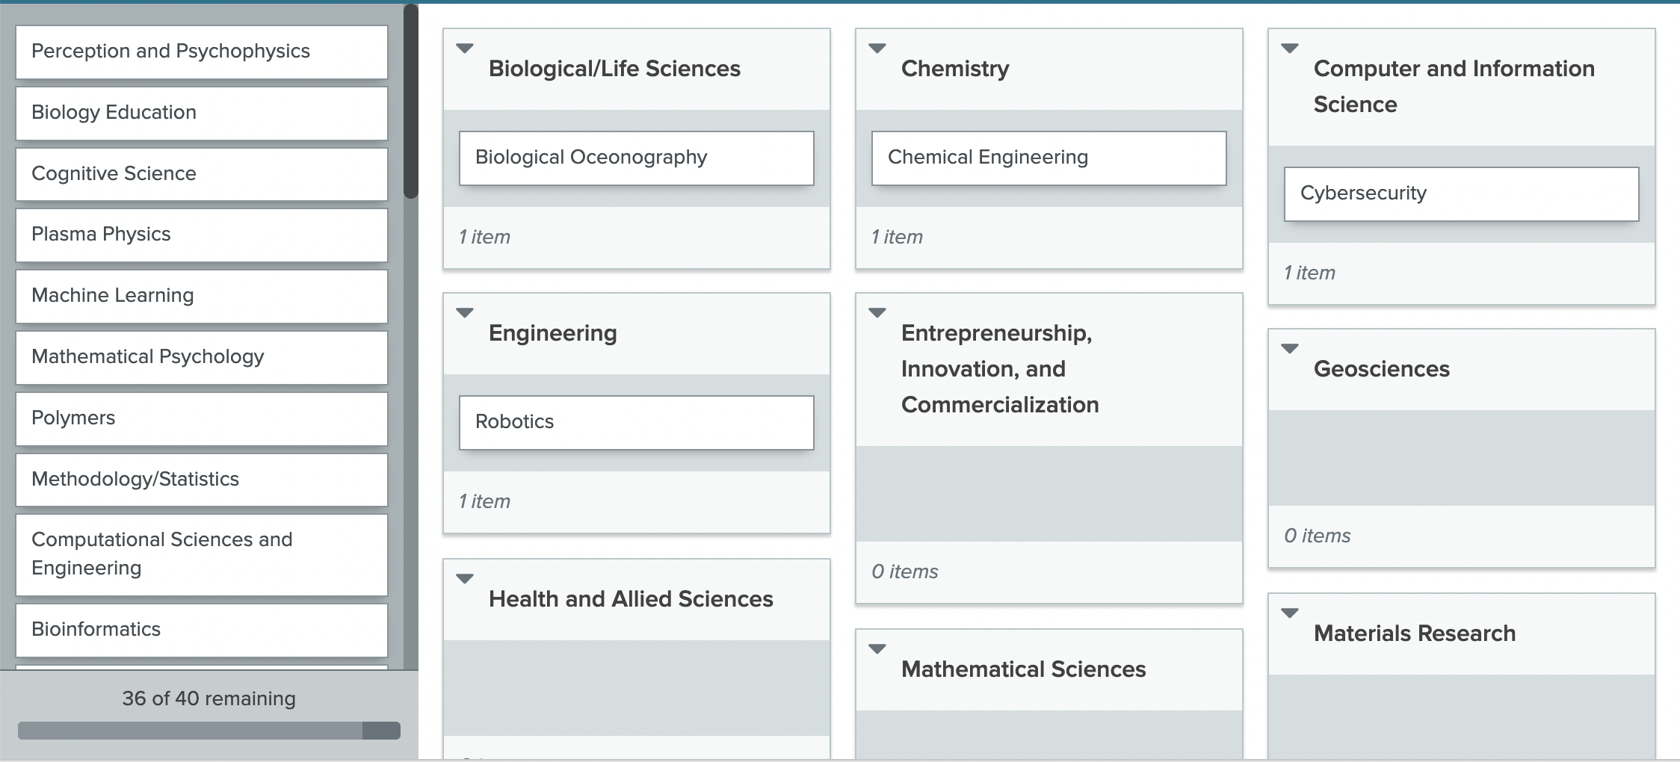
Card Sorting Study Overview
Example Card Sort Screen
Users dragged and dropped cards (subdisciplines) from the left onto categories (disciplines) on the right.

Slide 5
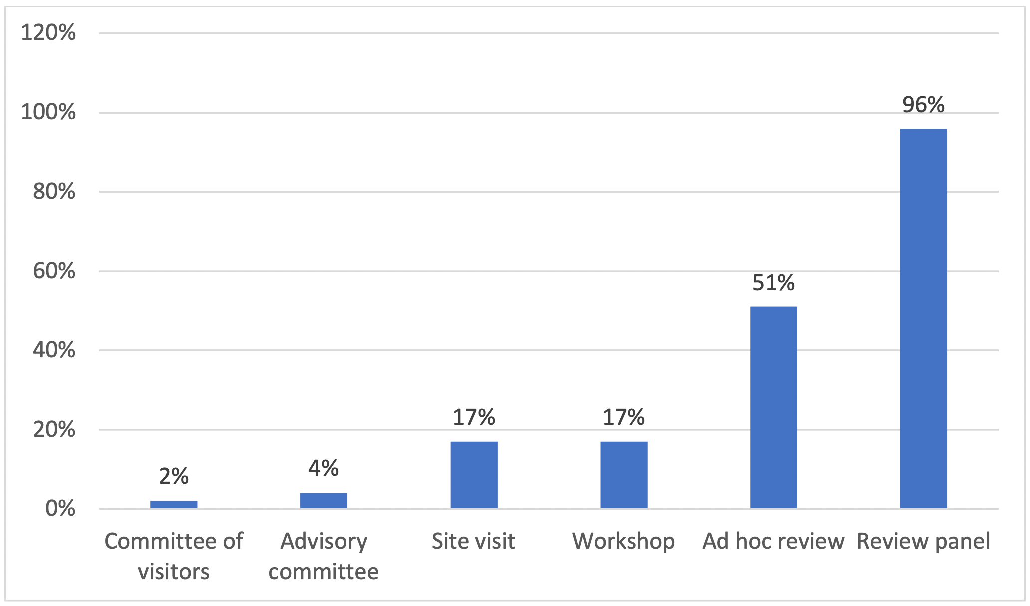
Card Sorting Participants
What types of meetings have you participated in in the past year?

Slide 6
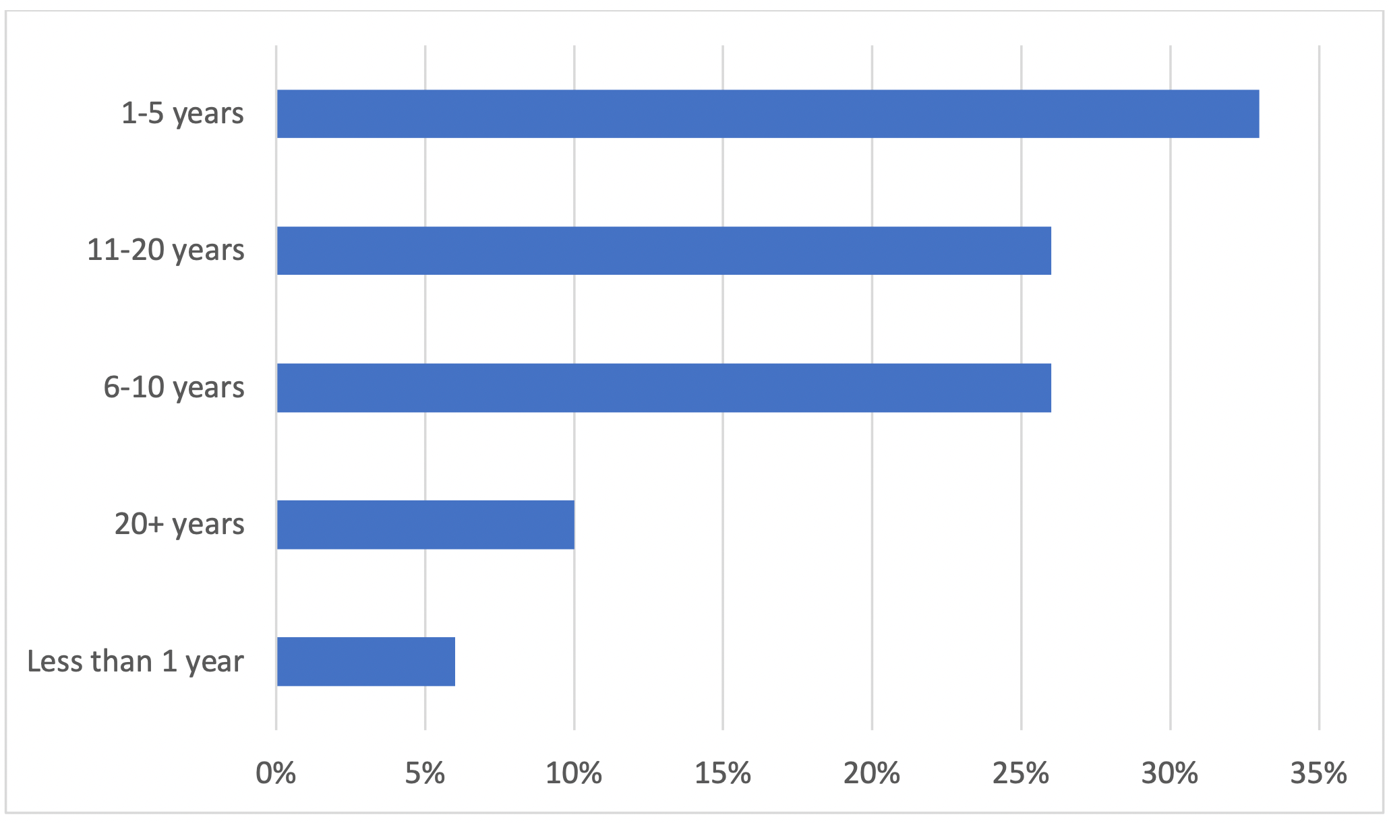
Card Sorting Participants
How long have you been a meeting participant?

Slide 7
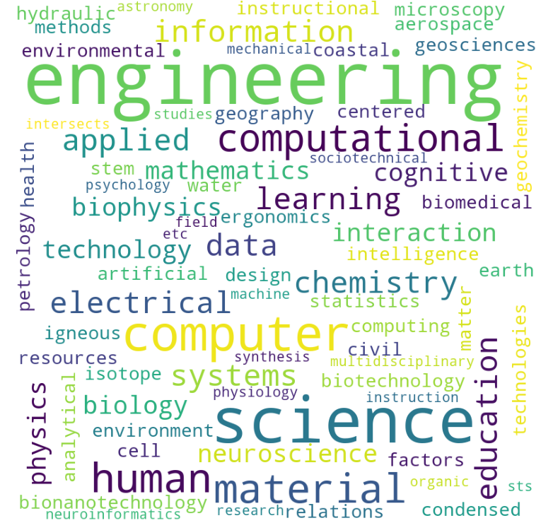
Card Sorting Participants
What is your discipline/subdiscipline?
Category | Percentage
Multidisciplinary | 43%
Computer and Information Science | 12%
Engineering | 12%
Biological/Life Sciences | 8%
Materials Research | 8%
STEM Education | 4%
Geosciences | 4%
Other | 8%

Slide 8
Participant Feedback
When being selected as a good fit for a review panel or other meeting type, which terminology makes more sense to you?

Slide 9
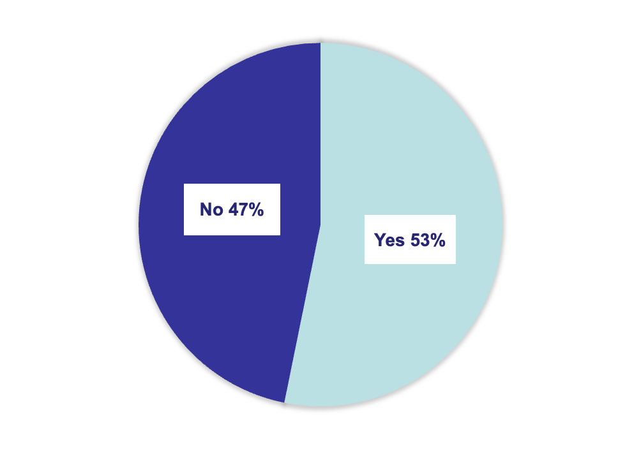
Participant Feedback
Was your discipline included in the list of cards you sorted?

Slide 10
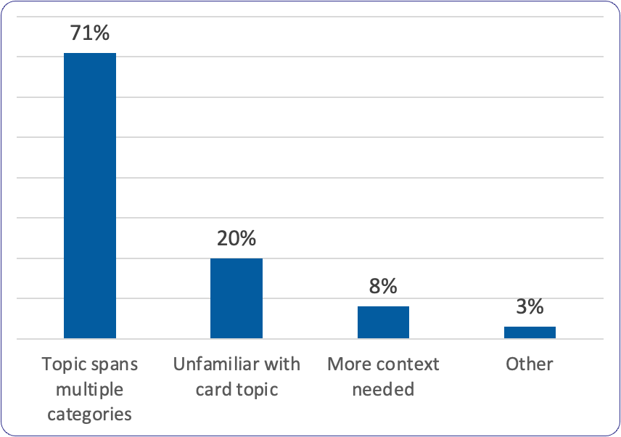
Participant Feedback
Were any of the items difficult to categorize? Please explain.

Slide 11
Key Findings: Users vs. NSF
Users categorized subdisciplines the same way as NSF about half the time, based on the most recent list of disciplines: AcctMgmt_AreasOfExpertise_2022-07-26v2.xlsx (nsf.gov)

Slide 12
Category | Agreed
Biological/Life Sciences | 43%
Chemistry | 50%
Computer and Information Science | 89%
Engineering | 80%
Entrepreneurship, Innovation, and Commercialization | 0%
Geosciences | 25%
Health and Allied Sciences | 67%
Materials Research | 86%
Mathematical Sciences | 100%
Organism | 0%
Physics and Astronomy | 75%
Psychology | 83%
Social Sciences | 0%
STEM Education | 40%
User Concurrence
For half the categories, users agreed with each other
50% of the time or less.
This heatmap shows the percentage of card sort participants who agreed on the cards in each category.

Slide 13
Key Findings
Categorical Agreement (most to least agreement between users)

Slide 14
Key Findings
Least to Most Popular Categories
(number of cards in each category, based on highest percentage of votes per card)

Slide 15
Key Findings
Users most frequently disagreed about how to categorize cards where the categories overlap.
Organism
Chemistry
Biological/Life Sciences
Geosciences
Health and Allied Sciences
Psychology
Social Sciences
Computer and Information Science
Engineering
STEM Education

Slide 16
Participant Comments
Themes
Cross-discipline areas of expertise
Areas of expertise that are not category-specific
Sentiments
“Do we really want to limit ourselves to keywords? Would we not do better within a machine learning context mining the entire Project Summary and Project Description to help identify logical areas of expertise?”
“It was so difficult I see very little use coming from these categories and subcategories.”
“Many crossed boundaries, some had no home. Some were too vague.”
“Interesting activity!”

Slide 17
Next Steps
The Team will:
  Identify cards that caused the most confusion and discover additional trends
  Explore alternative strategies for surfacing areas of expertise
  Create wireframes with recommendations and present to DIS and working group
  Consider validating changes with users Post-MVP

